Slide 1
LPC2148-Timer/Counter

Slide 2
Introduction
Timer is a
specific type of clock which is used to measure the time intervals.
It provides/measures the time interval by counting the input clocks.
Every timer needs a clock to work.
We can provide/measure any time interval if we know the time of one clock period.
e.g. Let’s say we have 1 kHz input clock frequency for the timer unit, then,
We can calculate time of one clock period as,
Time of one clock period = 1 / clock frequency
= 1 / 1000
= 1milliSecond
i.e. 1000 clock counts provide a time interval of 1 second, and hence we can provide 1 second delay with these 1000 clock counts.

Slide 3
Counter is
the unit which is similar to Timers but works in a reverse manner to the timers.
It counts the external events or we can say external clock ticks.
It is mostly used to measure frequency from the counts of clock ticks.
e.g. Let’s say Counter is measuring counts of external clock ticks, and frequently its count reaches 2000 in one second i.e. 2000 clock ticks/second.
Then, we can calculate external clock frequency as,
External clock frequency = count of clocks / one second
= 2000 / 1
= 2 kHz
Hence, we can measure such external clock/event frequencies using counter.

Slide 4
LPC2148 Timer& Counter
LPC2148 has two 32-bit timers/counters
Timer0/Counter0 & Timer1/Counter1.
LPC2148 Timer has input of peripheral clock (PCLK) or an external clock. It counts the clock from either of these clock sources for its operation.
Timer and Counter functionally same, except timer uses the peripheral clock (PCLK) for its timing, while counter uses an external source
LPC2148 Timer/Counter can generate an interrupt signal at specified time value.
LPC2148 has match registers that contain count value which is continuously compared with the value of the Timer register. When the value in the Timer register matches the value in the match register, specific action (timer reset, or timer stop, or generate an interrupt) is taken.
LPC2148 has capture registers which can be used to capture the timer value on a specific external event on capture pins.
We have prescaler option to divide timer input frequency

Slide 5
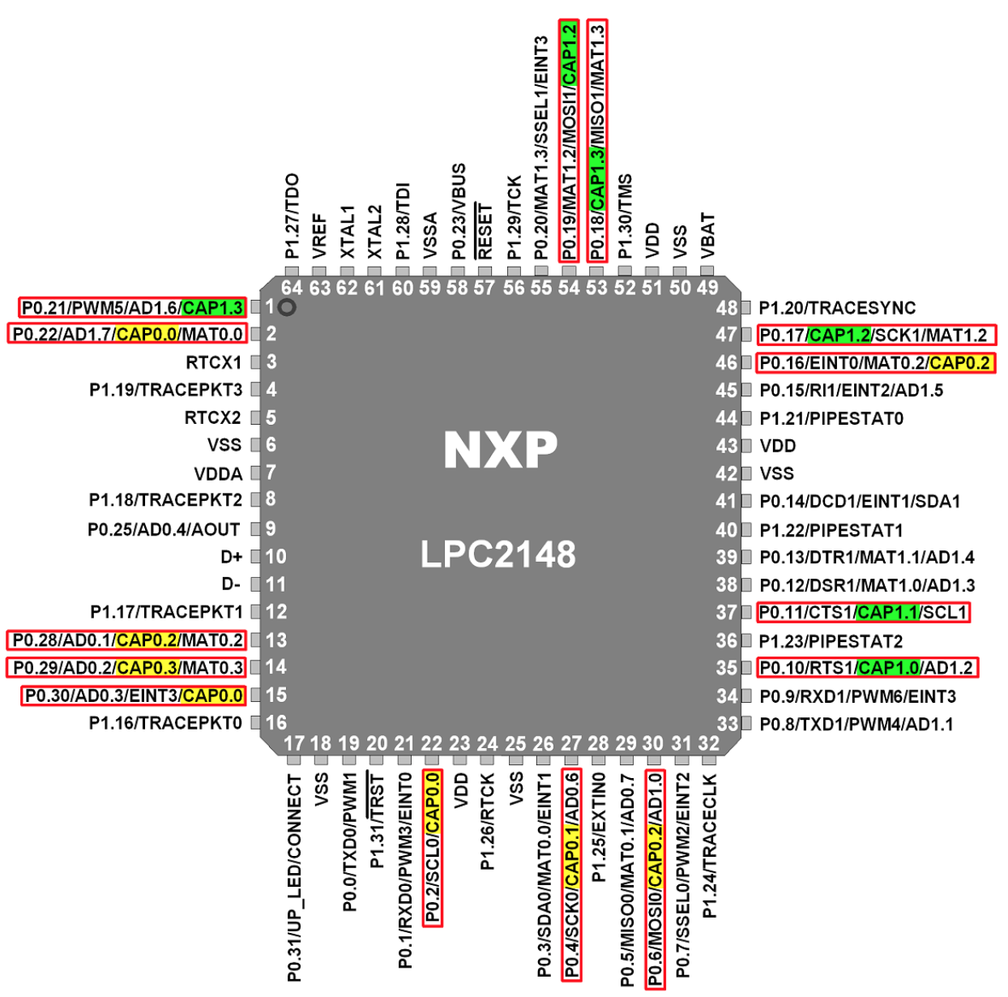
Timer Capture Mode
LPC2148 Timer includes input capture feature, using which we can capture/trap the timer counter value on events like rising edge (positive going) and falling edge (negative going). With this function, we can measure frequency, pulse width, duty cycle of the input signal
The Capture Control Register decides which event is to be recorded (e.g. rising/falling edge or both) and whether an interrupt is to be generated.
On each capture event on a capture pin, corresponding capture register gets copied with the TC (Timer Counter) value

Slide 6
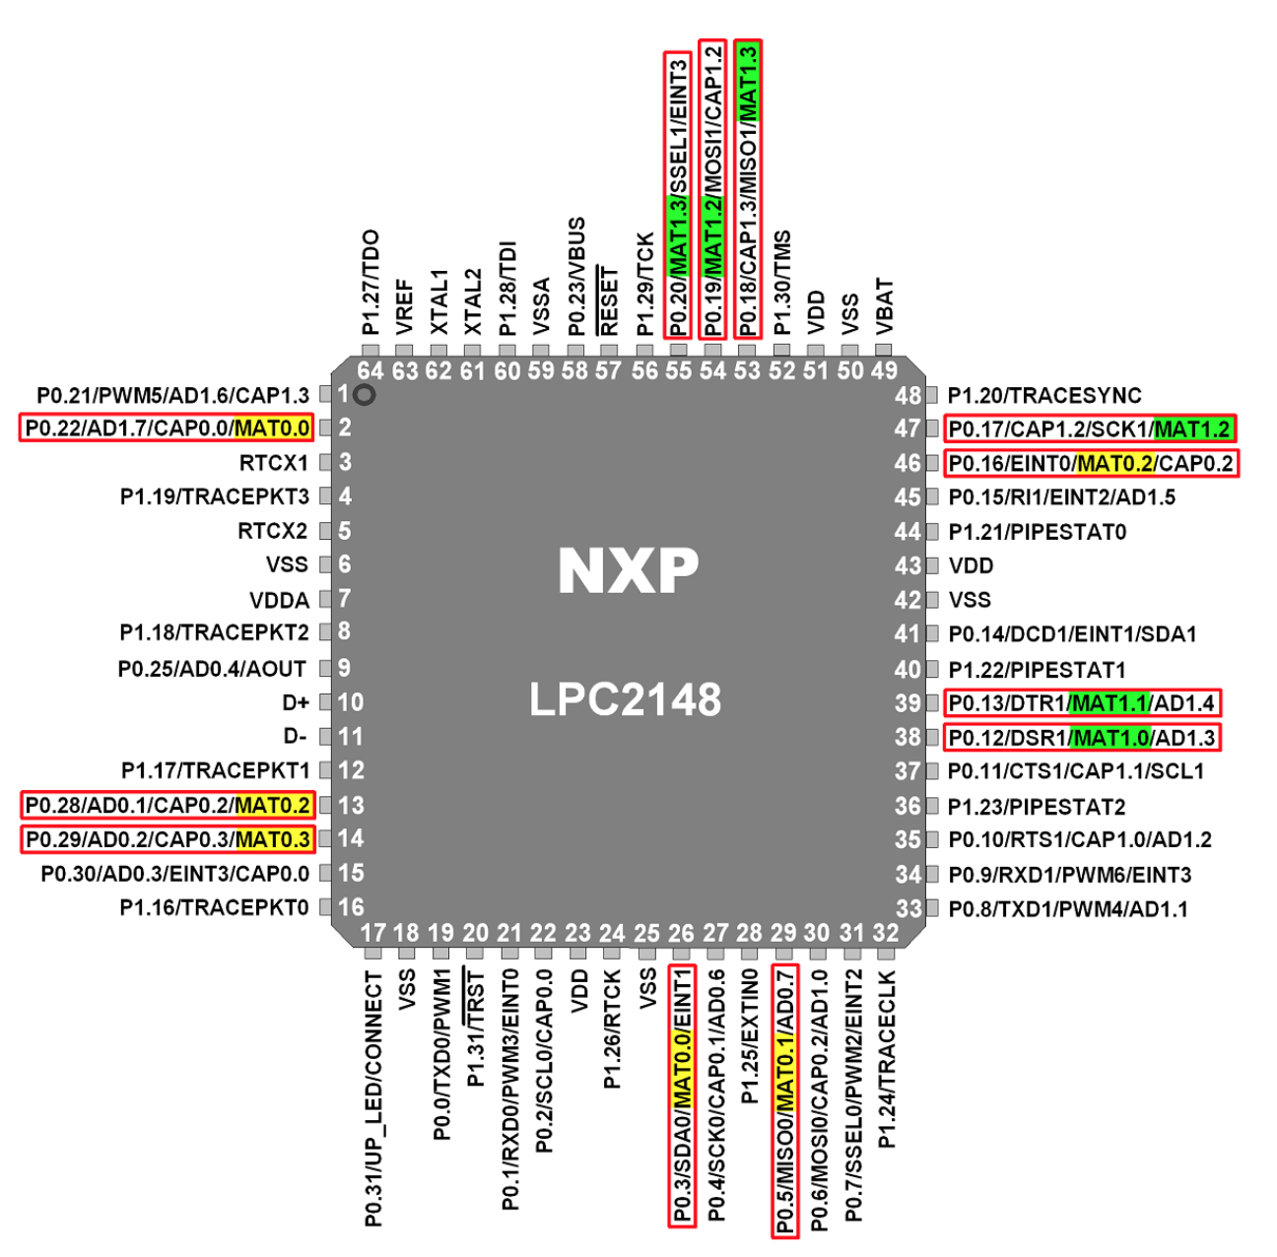
Control Timer and output - Match
This 32-bit value is written in Match Register (MR) and continuously compared with 32-bit Timer Counter (TC) value.
When this match register value and Timer Counter (TC) value are equal, we can reset/stop Timer Counter (TC) and can generate an interrupt.
Timer counter (TC) counts the input PCLK (Peripheral Clock) i.e. one count of Timer Counter (TC) is equal to the one cycle of PCLK
We can also extend one count of Timer Counter by several PCLK clocks using the Prescale Counter (PC). Prescale Register (PR) is used to set the maximum value for PC.
We can make specific pins (also called as match pins) of LPC2148 High/Low/Toggle on the event match occurrence.

Slide 7
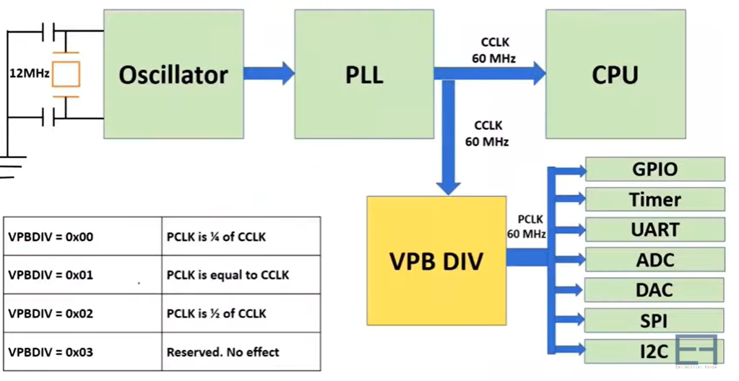
Clock flow of LPC2148 -------------------------------------------------------------

Slide 8
Timer 0 in LPC2148

Slide 9
Special Function Registers (SFR)
Timer 0 Timer Control Register – T0TCR
Timer 0 Counter Control Register – T0CTCR
Timer 0 Timer Counter Register- T0TC
Timer 0 Prescale Register – T0PR
Timer 0 Prescale Counter Register – T0PC
Timer 0 Match Registers (MR0 to MR3) - T0MR0-T0MR3
Timer 0 Match Control Register – T0MCR
Timer 0 Interrupt Register – T0IR

Slide 10
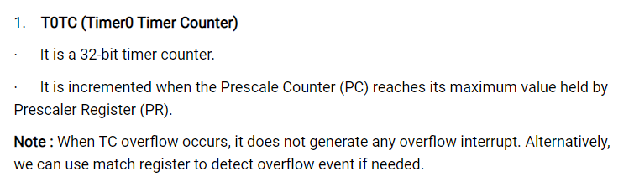
1. Timer Counter Register- T0TC
32-bit registers
Range of counting from 0 to 0xFFFFFFFF and then wraps back to the 0x00000000
This register is incremented on every tick of the clock ( i.e. PCLK), if the prescale counter is made 0

Slide 11
2. Timer 0 Timer Control Register – T0TCR
8-bit register
Only lowest 2 bits are used
Bit 0- Enable bit
1 : counter is enabled and starts. T0TC register is incremented for every clock cycle of PCLK
Bit 1- Reset bit
1: the counter reset on the next positive edge of PCLK

Slide 12
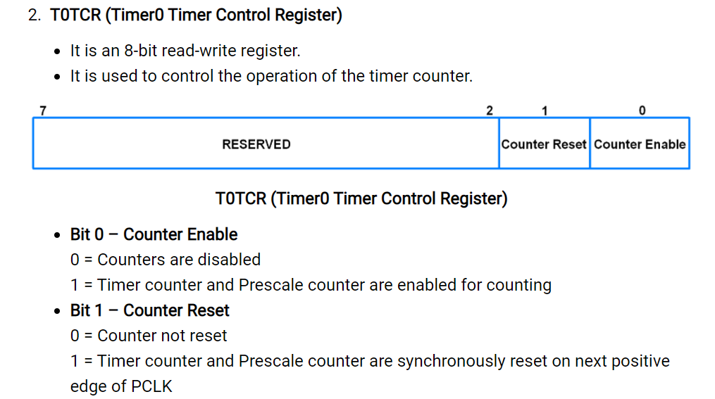

Slide 13
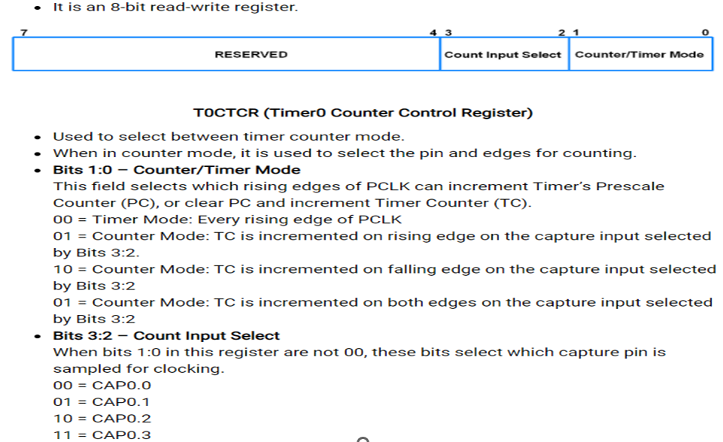
3. Timer 0 Counter Control Register

Slide 14
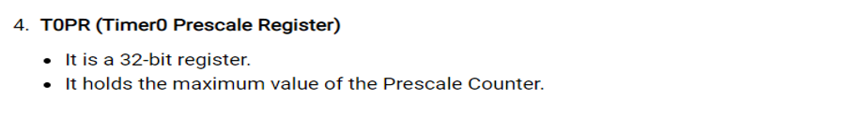
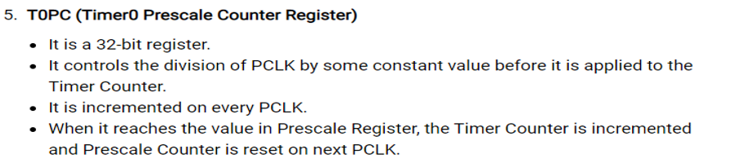
4. Timer0 Prescale Register
5. Timer0 Prescale Counter Register
--------------------------------------------------------------------------------------------------------------------------------------------------

Slide 15
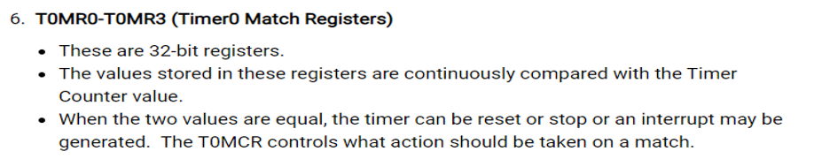
6. Timer 0 Match Register – T0MR0-T0MR3
Match Registers (MR0 to MR3)
4 -32-bit match registers are available : MR0 to MR3
One match register may be sufficient for one timer operation
Loading number into the match register

Slide 16
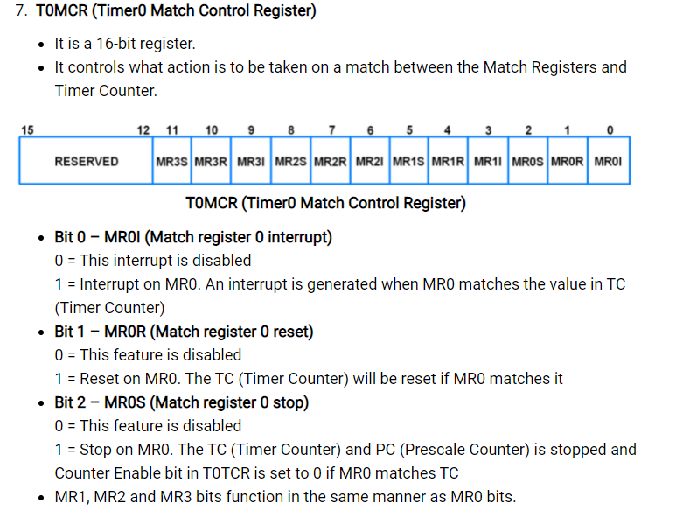
7. Timer 0 Match Control Register-T0MCR

Slide 17
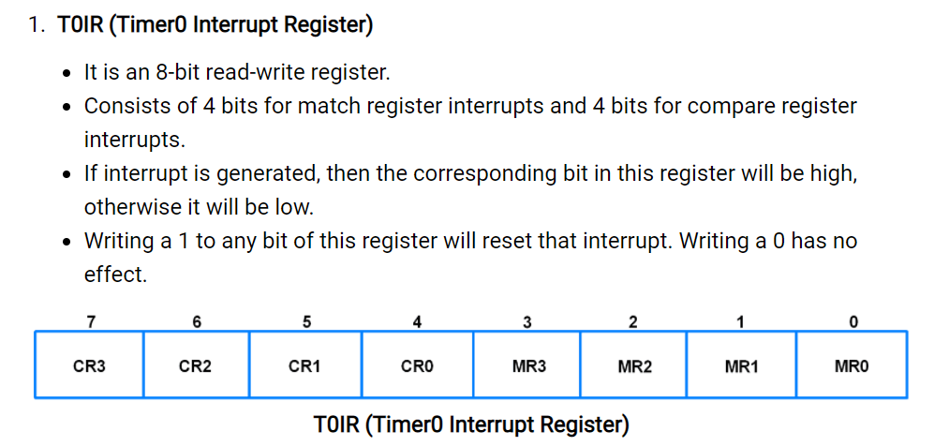
8. Timer 0 Interrupt Register

Slide 18
Simplified Block Diagram of Timer Unit
Match Control Register
Match Register
Control
Stop
=
Reset
Timer Count Register
Timer Control Register
Pre scaler
PCLK

Slide 19
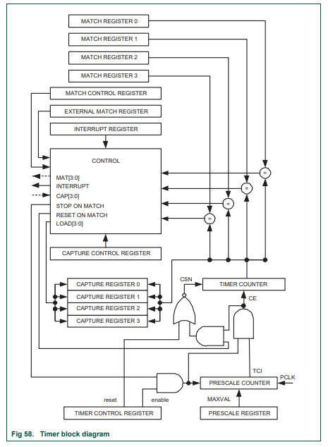

Slide 20
Write a program to generate the square wave of 1Hz frequency on P0.0 pin of LPC2148 using the internal timer.

Slide 21
Prescaler Register (PR) for 1KHz (1ms) Timer clock
PR Register is the 32-bit register used to divide the input frequency by desired value.
Prescaler value Register (PR) = PCLK frequency / TCLK frequency
=60MHz/1KHz
=60,000
PR =60,000-1 = 59,999
PCLK
60MHz
Prescaler (PR)
TCLK
1KHz
Timer counter (tc)

Slide 22
Timer 0 Configuration Steps for 1KHz (1ms time period)
Set T0CTCR =0X00 (Count Control Register --> Set as a Timer
Set T0PR =59,999(Prescale Register)
Set T0TCR =0X02 to reset Timer – which resets PR and TC
Set T0TCR = 0x01 to Enable the Timer when required (Timer Control Register)
Reset T0TCR to 0x00 to Disable the Timer when required (Timer Control Register)

Slide 23
Embedded C program to generate 1Hz (1sec) pulse
void delayms(unsigned int);
void pll();
void pll()
{
PLL0CON=0X01 //PPLE=1&PPLC=0 so it will be enabled but not connected
PLL0CFG=0X24 //Set up PLL for CCLK=60MHz
PLL0FEED=0XAA //feed sequence
PLL0FEED=0X55
while((PLL0STAT&(1<<10))==0); //check whether PLL has locked on to the desired frequency
PLL0CON=0X03 //enable & connect PLL
PLL0FEED=0XAA
PLL0FEED=0X55
VPBDIV=0X01 //PCLK is same as CCLK, ie 60MHz
}

Slide 24
void delayms(unsigned int z)
{
T0CTCR =0X0; //Select Timer mode
T0PR=59999; //Prescaler value for 1ms
T0TCR=0X02; //Timer reset
T0TCR=0X01; //Timer ON
while(T0TC<z);
T0TCR=0X00; //Timer OFF
}

Slide 25
Timer.c (main file)
#include <lpc214x.h>
#include “pll.h”
int main(void)
{
IO0DIR=(1<<0); //make P0.0 as o/p pin
pll(): //Fosc=12MHz, CCLK=60MHz, PCLK=60MHz
while(1)
{
IO0SET|=(1<<0);
delayms(500); //0.5ms ON
IO0CLR|=(1<<0);
delayms(500); //0.5ms OFF
}
}

Slide 26
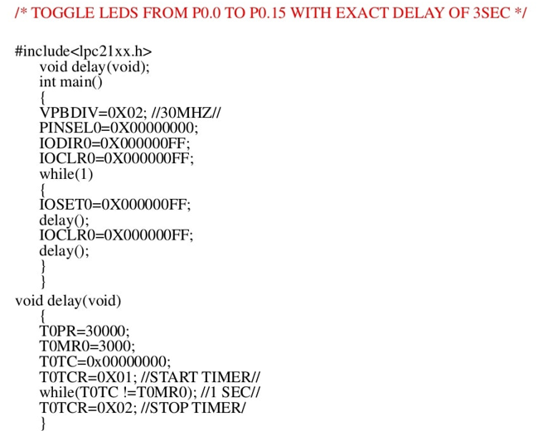

Slide 27
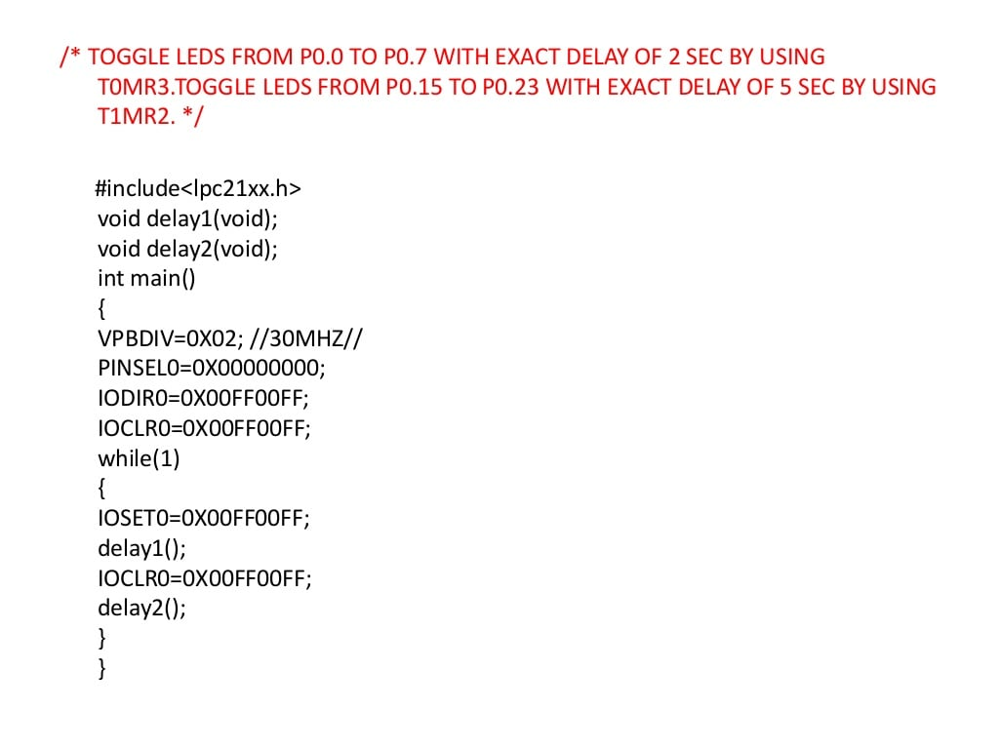

Slide 28
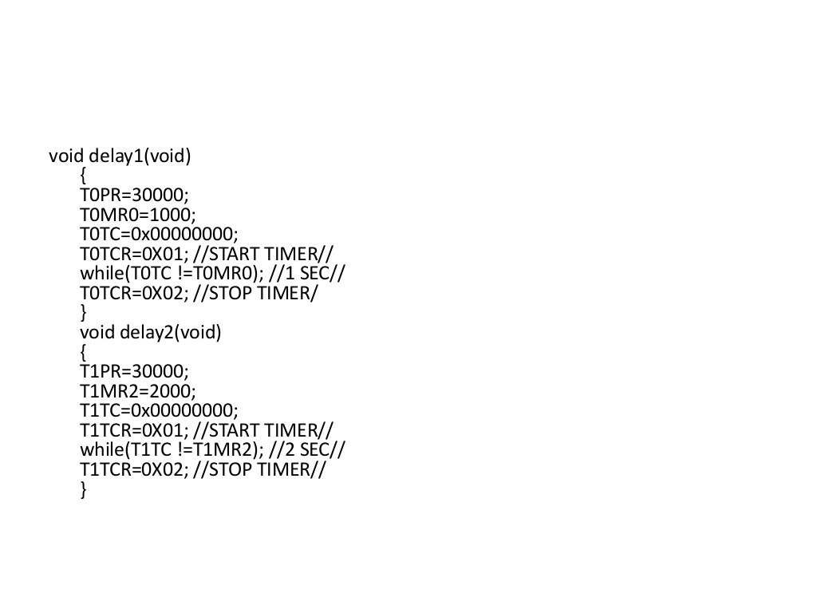

Slide 29
Reference
LPC2148 Timer C Program – YouTube
LPC2148 Timer/Counter | ARM7-LPC2148 (electronicwings.com)

Slide 30
THANK YOU

